Slide 1
MATH and Science Concepts
Important Concepts to be taught to young children

Slide 2
The 5 Strategic Practices
Mathematize the world around us
There is some sort of math concept in almost everything we do. Help to bring this idea to the children’s attention.
Make Mathematics more than the manipulatives
Children must make connections between concrete experiences, symbols, pictures, and language
Recognize receptive understanding
Be alert to nonverbal indicators of what a child is thinking-gestures and actions
Get mathematics into children’s eyes, hands, and feet
Children learn best when new ideas are presented in multiple different ways
Scaffold children to construct their own understanding
Nurture children to construct their inborn instincts to question and problem solve

Slide 3
Sets
A set is any collection that is grouped together in some meaningful way
Big Ideas about Sets
Attributes can be used to sort collection into sets
The same collection can be sorted in different ways
Sets can be compared and ordered
What do your kids naturally sort in the classroom?
Activity
People sort

Slide 4
Number Sense
The ability to understand the quantity of a set and the name associated with that quantity.
One of the most difficult concepts to teach children.
Activity
Number Sense Nonsense

Slide 5
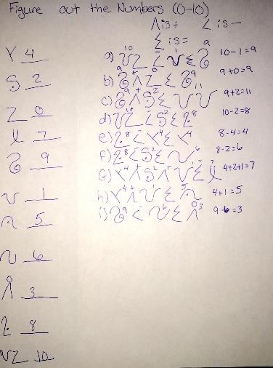

Slide 6
Number Sense continued
Big Ideas about Number Sense:
Numbers are used in many ways, some more mathematical than others
Quantity is an attribute of a set of objects and we use numbers to name specific quantities
The quantity of a small collection can be intuitive without counting (Subitizing)
Cardinal Numbers: Answer how many or how much
Ordinal Numbers: Refer to position in a sequence (1st, 2nd, 3rd)
Activity
Plates number game

Slide 7
Counting
Rote Counting: Reciting the number names in order from memory.
Rational Counting: Matching each number name in order to an object in a collection.
Four Basic Rules:
Stable order
1-1 Correspondence
Order Irrelevance (order of which the items are counted in
Cardinality
Activity
Bug counters with Miss Spider’s Tea Party

Slide 8
Number Operations
Operations are tools we use to find answers to the questions in our story (how many now? How many more? How many fewer?)
Counting all: When adding on to a set, the child will start from the beginning and then add on the rest.
Ex: 5+2
The child will say 1, 2, 3, 4, 5 and then 6, 7
Counting on: Counting up from a previous number instead of starting back at the beginning.
Ex: 3+2
“I have 3, so 4, 5, 6”

Slide 9
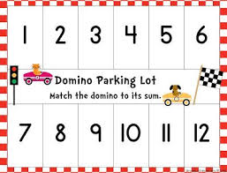
Number Operations Cont.
It’s important to give children multiple ways to understand numbers such as acting it out, drawing it, using manipulatives, and stories with math.
Children who have lots of experiences with subitizing, matching, and comparing will be able to develop a mental number line.
Activity
Domino Parking Lot

Slide 10
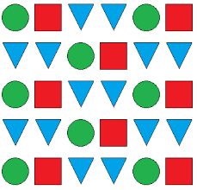
Patterns
A pattern is a predictable sequence that can be found in physical and geometric Situations as well as in numbers
Visual (floor tiles)
Auditory (Song/Music)
Temporal (Days of the Week)
Numerical (Square numbers)
Repeating Patterns:
Contain a segment that continuously repeats
Growing Patterns:
Increase or Decrease by a constant amount

Slide 11
Patterns
Concentric Patterns:
Circles or rings that grow from a common center
Symmetrical Patterns:
Have segments that repeat, but instead of being in a line, they are organized as mirror images of one another.
Activity
People Patterns
Music Patterns

Slide 12
Measurement
Any process that produces a quantitative description of an attribute: length, circumference, weight, temperature, volume, number.
Direct Comparisons: lining two objects up next to each other to see which is biggest
Indirect Comparisons: Utilizing representations to stand in for the attributes being compared
Tips for Measurement
To have meaning, words like big, small, and wide need comparisons
Use real-life authentic problem solving situations
Activity
Measuring with blocks

Slide 13
Data Analysis
What can data analysis help to teach?
One-one correspondence
Counting
Comparing more/less
Numerals and names
Correspondence between numerals and quantity
Why use data analysis?
To answer unobvious questions
Involves children in the question
Work together to determine how to gather and organize the information
Surveys
Fact finding surveys: Objective data about objects or ways of doing things.
Preference Surveys (polls): People select among 2 or more options to indicate their personal preference.

Slide 14
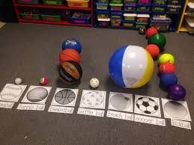
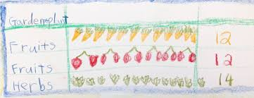
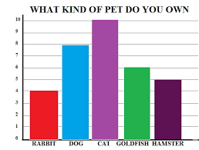
Data Analysis
Graphs
Object Graphs:
Allow Children to literally see the answer when
comparing sets to discover “which has more?” and
“how many more” without having to count.
Pictograph:
Each object is represented by a picture, either drawn
or real
Bar Graph
Data can be represented by Xs or connecting cubes
Or dot stickers in columns or rows labeled to show the
Frequency of each value

Slide 15
Spatial Relationships
Spatial relationships…
Describe locations with words/gestures
Involve drawing maps/constructing models
How to help teach spatial relationships
Encourage block play
Add figures and care to block areas
Display posters of buildings
Hang pictures to capture representations
Model and help develop the vocabulary
Utilize different spaces
Small: legos, duplos, manipulatives
Medium: blocks, boxes, house
Large: climbers, swings, slides

Slide 16
Spatial Relationships
Spatial Skills
Proximity: Positions, direction, distance (Checkers)
Separation: Part-whole (legos)
Order: Sequence (Very Hungry Caterpillar)
Enclosure: Inside, outside, boundary (Bean toss, templates)
Activities
Hide and seek, obstacle courses, mapping

Slide 17
Shapes
Teaching Shapes
Show children lots of different examples and let them combine, rotate, and compare.
Blocks are great for exploration of shapes!
Include 3D items
Define shapes by attributes.

Slide 18
Shapes
Level of difficulty of learning shapes
Matching
Sorting
Naming
Drawing/copying
Games to help learn shapes
Shape Bingo
Tangrams (allows children to make pictures by combining shapes)
Blocks

