Slide 2
YScreen
By detecting developmental delays early, you as an educator have the power to change lives and educational outcomes for children! If delays are identified, Easter Seals DuPage and the YWCA CCR&R can offer the support needed to be school-ready and to build a foundation for a lifetime of learning. Research proves that when children receive the right treatment and therapy they need before age five, they are more prepared to learn alongside their peers, build lifelong skills and achieve their dreams.

Slide 4
What is ASQ?
Widely used developmental screening tool
A series of illustrated parent or caregiver completed questionnaires
Used to accurately identify children who may be at risk for developmental delays
Designed to encourage parent involvement and education
Reliable and rigorously tested
Online questionnaire and paperless data management systems

Slide 5
Y Choose the ASQ tool?
Proven accurate by new research—highly reliable and valid
“Anytime” screening
Fast and easy scoring
Educates families and is parent friendly
Strengths based—it’s easy to share results and talk about a child’s development

Slide 6
Getting Started
Upon enrollment parents should be informed about ongoing observations and developmental screenings
Parent release
Information sharing

Slide 7
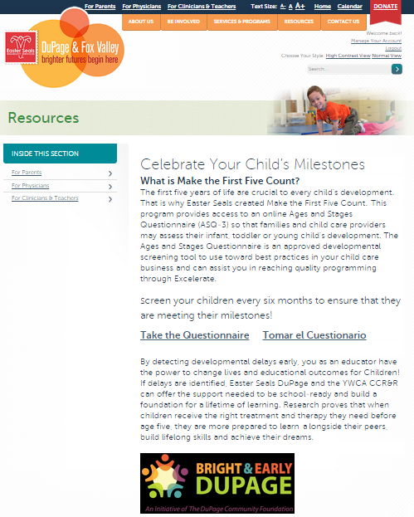
Using the ASQ tool
Visit the website at YScreen.AskEasterSeals.com
Click on “Take the Questionnaire”
Notes:
*****Make sure to tell participants NOT to put www. in front of Yscreen.AskEasterSeals.com.
Internet shows “no results”

Slide 8
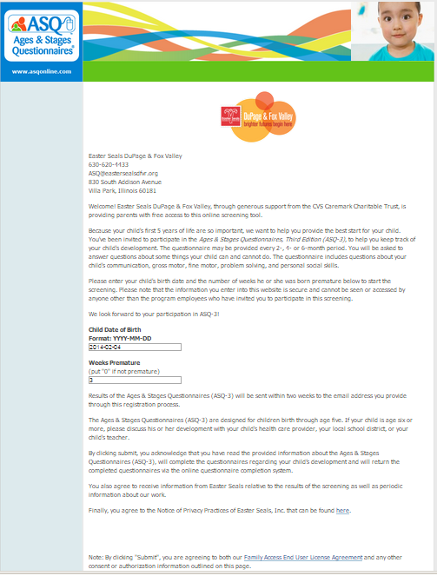
Using the ASQ tool
Enter the child’s date of birth
Enter the number of weeks the child was premature if applicable otherwise enter “0”
Click “submit”
Notes:
Feedback from Thursday’s presentation:
Participants REALLY wanted to see screens
We have hardcopies to pass out so participants can look over

Slide 9
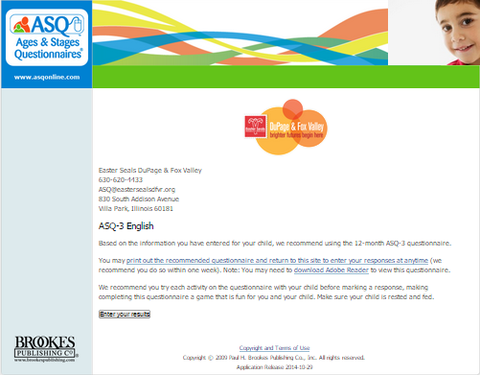
Using the ASQ tool
Click the “enter results” button to begin questionnaire

Slide 10
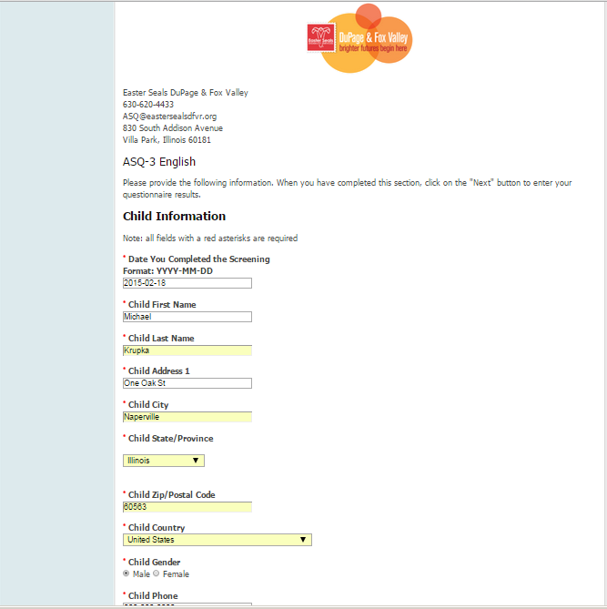
Using the ASQ tool
Enter child’s first and last name
Enter child care provider’s information
Enter the email address where the results should be sent
Click “next”

Slide 11
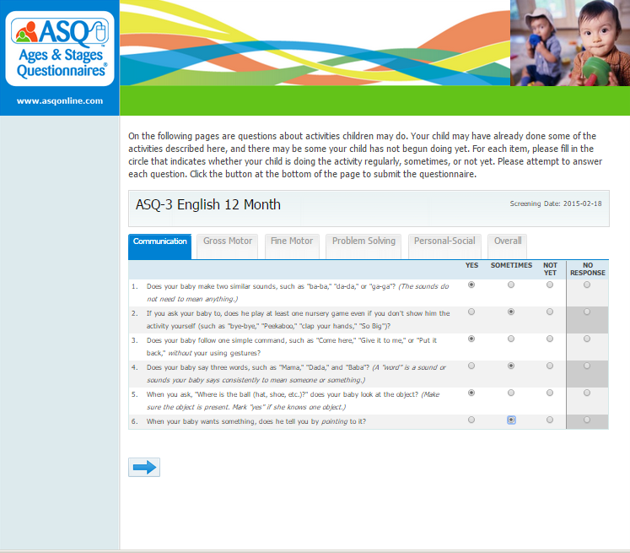
Using the ASQ tool
Each tab assesses a separate domain
Complete all questions in each tab
Click on blue arrow to move to the next tab

Slide 12
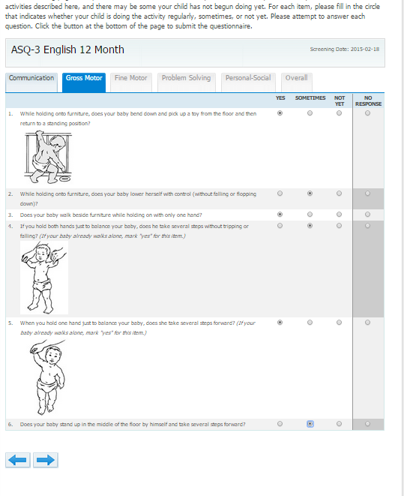
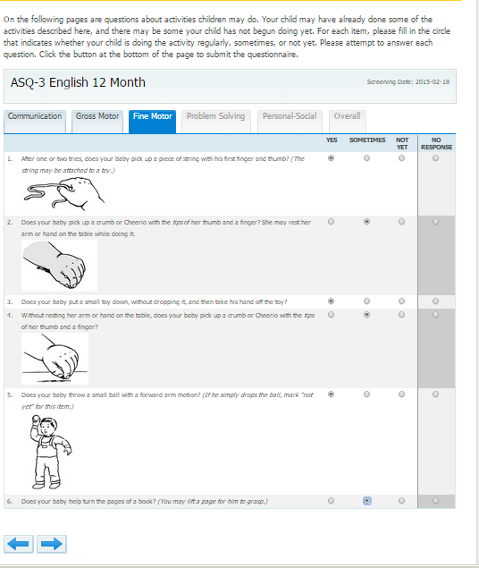
Using the ASQ tool

Slide 13
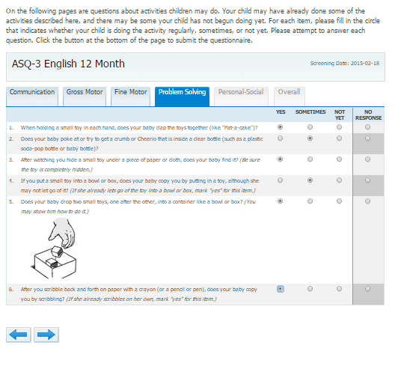
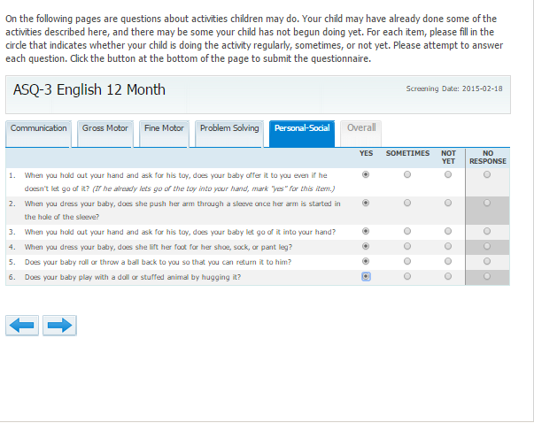
Using the ASQ tool

Slide 14
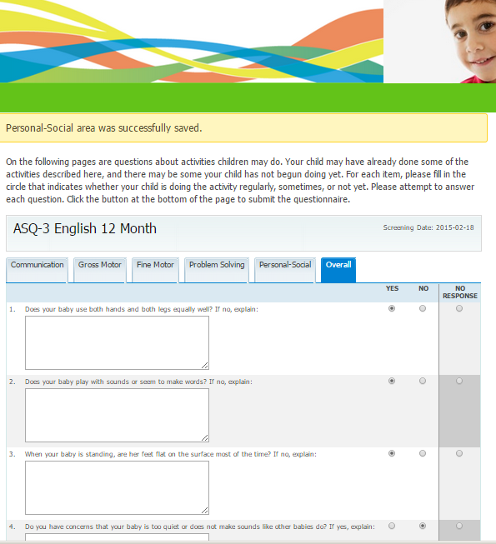
Using the ASQ tool
Answer the narrative questions
Click submit when all questions are complete

Slide 15
Using the ASQ tool

Slide 16
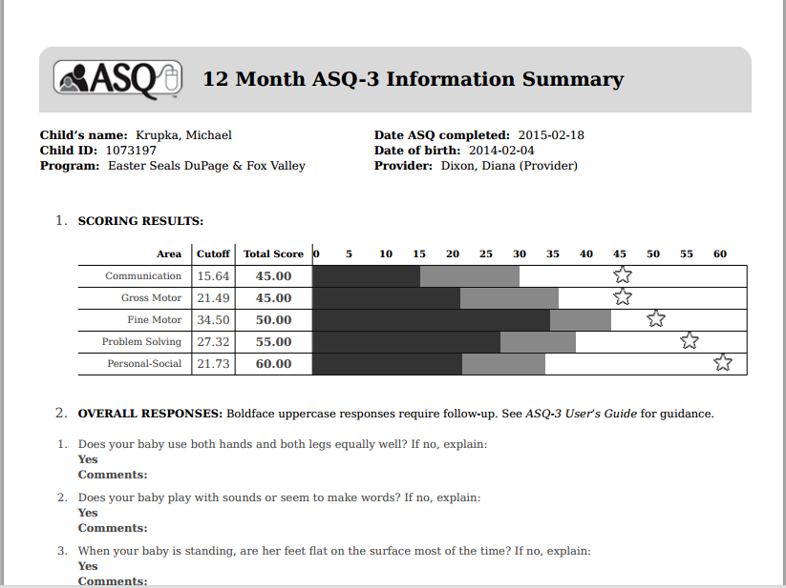
Scoring the Results
No calculations needed
Results are scored by a developmental screening professional
Receive within 2 weeks via email

Slide 17
Sharing Results with Parents
Private, confidential and convenient for families
Only a screening not a diagnosis
Consider health, cultural and environmental factors
Emphasize strengths
Helping parents understand the results:
White area – meeting milestones
Gray area – further observation, rescreen
Black area – further evaluation is required
Empower parents to advocate for their child
Provide resources
Provide referral information as needed
Notes:
Feedback from Thursday’s Presentation:
Slide should be moved so it comes after “Scoring the Results”
Need to change “cutoff” verbiage to:
Score in white area – meeting milestones
Gray area – further observation, rescreen
Black area – further evaluation required

Slide 18
Advantages
Free – at least $300 savings
Organized efficient way of keeping developmental records of each child’s progress
Accepted by Illinois State Board of Education
Preferred by home visiting programs
Play based and easy to administer
Can assist in curriculum planning
Resources if delay is identified

Slide 19
ExceleRate Best Practices
Provides information so that curriculum can best meet the needs of the child
Aligns with Illinois Early Learning and Development Standards
Aligns with ExceleRate Illinois
Choosing an assessment tool is a requirement for the silver & gold circles of quality.

Slide 20
Relationship Building
Provide information to parents regarding the importance of developmental screening
Daily information sharing between parent and provider to form a partnership
Sharing the information provides an opportunity for parents and teachers to work together to overcome challenges and celebrate strengths
Enrollment of Child
Informal observation of child and his/her development
Development Assessment

Slide 21
Conclusion
Visit the ASQ site to access the tool at YScreen.AskEasterSeals.com
Easter Seals and YWCA are here to provide support
Resources
Technical Assistance
Training
Notes:
AGAIN...remind participants NOT to put www. in front of YScreen

Slide 22
Notes:
(Read some of the points on the screen.)
Having a strong, widely recognized brand will help us to grow our resources, associations and participation.
Our branding will allow us to verbally and visually communicate who we are. And will become a part of something bigger than each of us. Because as the saying goes—the whole is more than the sum of its parts.

