Slide 1
Understanding and Using the Ages and Stages Questionnaire (ASQ)

Slide 2
Let’s take a look
Questions that you will answer through observation, play, and getting to know the children in your classroom.

Slide 3
Why Screen?
By detecting developmental delays early, you as an educator have the power to change lives and educational outcomes for children!
If delays are identified we can offer the support needed to be school-ready and to build a foundation for a lifetime of learning.
Research proves that when children receive the right treatment and therapy they need before age five, they are more prepared to learn alongside their peers, build lifelong skills and achieve their dreams.

Slide 4
What is ASQ?
Widely used developmental screening tool
A series of illustrated parent or caregiver completed questionnaires
Used to accurately identify children who may be at risk for developmental delays
Designed to encourage parent involvement and education
Reliable and rigorously tested
Online questionnaire and paperless data management systems

Slide 5
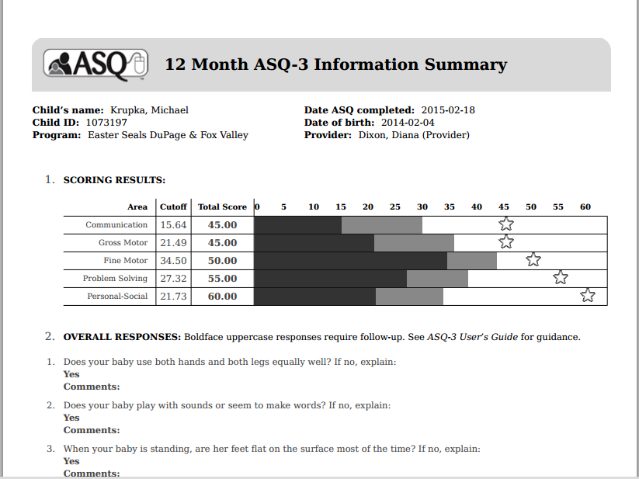
Scoring the Results
No calculations needed
Results are scored by a developmental screening professional
Receive within 2 weeks via email
ALL RESULTS WILL BE SENT TO PSCCFORMS@GMAIL.COM

Slide 6
Sharing Results with Parents
Private, confidential and convenient for families
Only a screening not a diagnosis
Consider health, cultural and environmental factors
Emphasize strengths
Helping parents understand the results:
White area – meeting milestones
Gray area – further observation, rescreen
Black area – further evaluation is required
Empower parents to advocate for their child
Provide resources
Provide referral information as needed

Slide 7
ExceleRate Best Practices
Provides information so that curriculum can best meet the needs of the child
Aligns with Illinois Early Learning and Development Standards & Creative Curriculum
Aligns with ExceleRate Illinois
Choosing an assessment tool is a requirement for the silver & gold circles of quality.

Slide 8
What, When, How?
Every new child to the center should be screened within the FIRST month of enrollment.
EVERY child should be screened before the FIRST parent/ teacher conference (new school year).
Any time you feel you want another opinion/ input/ information.

